Slide 1
MODULE1 ..PART3..IRS
Information retrieval system
1)Covered till data
1.1)motivation behind information systems ….analog to digital, structured to unstructured, text to multimedia
1.2) need for information systems..information, business, supply Chain, market interoperability, various products and services
1.3) components of information systems…hardware, software, communication, resources, policies and procedures
1.4) types of information systems…hierarchical …workers, middle managers, senior managers, executives
1.5) types of information..other as per applications

Slide 2
MODULE1 ..PART3..IRS
Information retrieval system
2) Information retrieval and data retrieval….differences
2.1)IR, process of storage, retrieval and evaluation of information from document repositories. DR, based on the query, the data from database is retrieved by DBMS.
2.2) IR, getting information about the subject( content based). DR, based keywords in users query only data is retrieved
2.3) Small error are unnoticed in IR as it is content based, but error are noticeable is keyword is wrong

Slide 3
MODULE1 ..PART3..IRS
Information retrieval system
2) Information retrieval and data retrieval…differences..Cont..
2.4) DR is well structured were as IR can be unstructured also
2.5) DR semantically very clear were as IR, more pains have to be taken to make it semantically clear
2.6)DR gives clear idea of the database system and IR puts a abstraction layer for database system
2.7)DR, result matching is perfect, in IR result matching may not be perfect
2.8)DR is a deterministic model and IR is probabilistic model

Slide 4
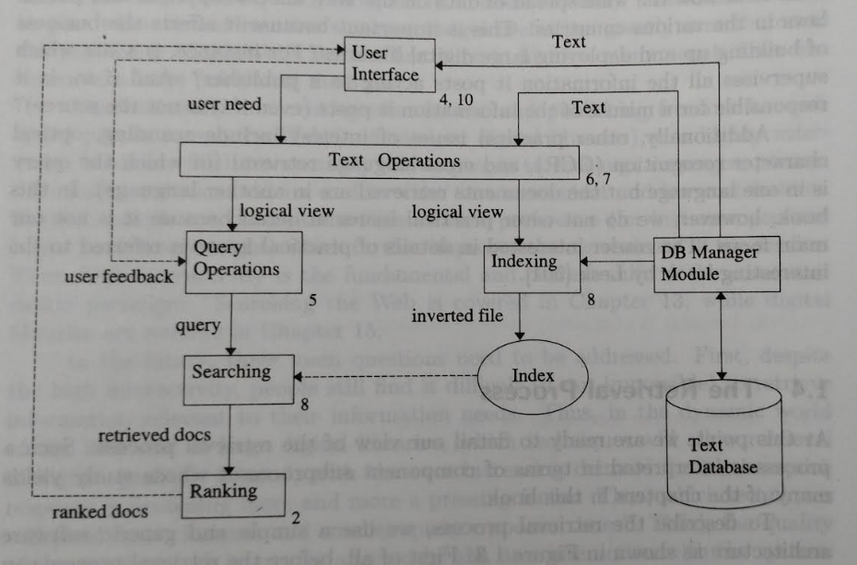
MODULE1 ..PART3..IRS
3)Information retrieval process…

Slide 5
MODULE1 ..PART3..IRS
3) Information retrieval process…
3.1)Software architectural model of IR process
Part1: storage and indexing
Database creation, i.e defining the text database. This is done by database manager
What is specified.. documents to be used, operations to be performed, text model i.e the text structure and what elements to be retrieved from it
Based on the operations , the text operations transforms the original document to a logical view of it.

Slide 6
MODULE1 ..PART3..IRS
Information retrieval process…
Software architectural model of IR process
Part1: storage and indexing…..cont
Then a index is assigned to this logical document by the database manager.
Part2: retravel process…
The user through user interface gives user needs
As per the need text operations are decided by parsing
The text operations are then represent as query operation

Slide 7
MODULE1 ..PART3..IRS
Information retrieval process…
Software architectural model of IR process
Part2: retravel process…Cont
The searching of the document is done by using indexing and the required document is retrieved
Part3:query response to user
Before sending to the user the documents are ranked as per their relevance
the documents are then grouped as sets and the most relevant set is sent first to the user

Slide 8
MODULE1 ..PART3..IRS
3) Information retrieval process…
Software architectural model of IR process
Part3:query response to user…cont
The user if not satisfied initiates a feedback which is then send for searching of the relevant documents
4)Search engines….
A search engine is a software system designed to carry out web searches.
web search sends web search query which the user enters into a web search engine to satisfy their information needs.

Slide 9
MODULE1 ..PART3..IRS
4)Search engines….cont
Web search queries are distinctive in that they are often plain text and Boolean search directives are rarely used.
They vary greatly from standard query languages, which are governed by strict syntax rules as command languages with keyword or positional parameters.
They search the World Wide Web in a systematic way for particular information specified in a textual web search query.
The search results are generally presented in a line of results, often referred to as search engine results pages (SERPs).

Slide 10
MODULE1 ..PART3..IRS
4)Search engines….cont
The information may be a mix of links to web pages, images, videos, infographics, articles, research papers, and other types of files.
Some search engines also mine data available in databases or open directories.
web directories, are maintained only by human editors,
search engines maintain real-time information by running an algorithm on a web crawler
Any internet-based content that can't be indexed and searched by a web search engine falls under the category of deep web.

Slide 11
MODULE1 ..PART3..IRS
4)Search engines….Types of query’s
4.1) Informational queries – Queries that cover a broad topic for which there may be thousands of relevant results.
4.2) Navigational queries – Queries that seek a single website or web page of a single entity
4.3) Transactional queries – Queries that reflect the intent of the user to perform a particular action, like purchasing a car or downloading a screen saver.
4.4)Connectivity queries – Queries that report on the connectivity of the indexed web graph (e.g., Which links point to this URL?.

Slide 12
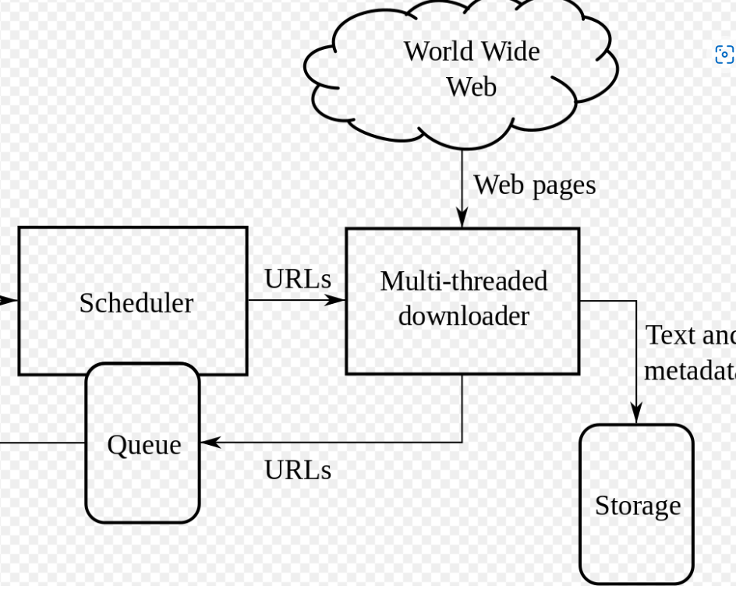
MODULE1 ..PART3..IRS
4)Search engines….working

Slide 13
MODULE1 ..PART3..IRS
4)Search engine….)processes followed
4.1.a)web crawling…
A Web crawler, also called a spider, spiderbot is an Internet bot that systematically browses the World Wide Web.
An Internet bot, web robot, robot or simply bot, is a software application that runs automated tasks (scripts) over the Internet to emulate human activity on the Internet, such as messaging and so on
it is operated by search engines for the purpose of Web indexing (web spidering)

Slide 14
MODULE1 ..PART3..IRS
4)Search engine….4.1)processes followed
4.1.a)web crawling… the process…cont
The web search engine will release the spider which will go from site by site
Each site has a protocol called as robot exclusion protocol which communicate with the spider so as to inform which part of the page to visit in their site as per the query
The results of search are sent back by the spider for indexing
4.1.b) indexing…
Search engine indexing is the collecting, parsing ( analyzing strings…

Slide 15
MODULE1 ..PART3..IRS
4)Search engine….4.1)processes followed
4.1.b) indexing…
…symbols so as to get its meaning. The documents are then indexed so that they can be selected
4.1.c) searching…
Query sent by user, indexed documents selected, ranked as per nearest to search query . Sets are formed and most matched set is sent first

Slide 16
MODULE1 ..PART3..IRS
Thank You

